Slide 1




The main event will begin soon. Please take your seat. Access the event program and music scores with this QR code =>

Slide 2
Raindrops on a Tin Roof: Exploring the Cyberinet
Matthew A. Bardin - PHD Candidate
Louisana State University - Experimental Music & Digital Media
04/18/2023

Slide 3

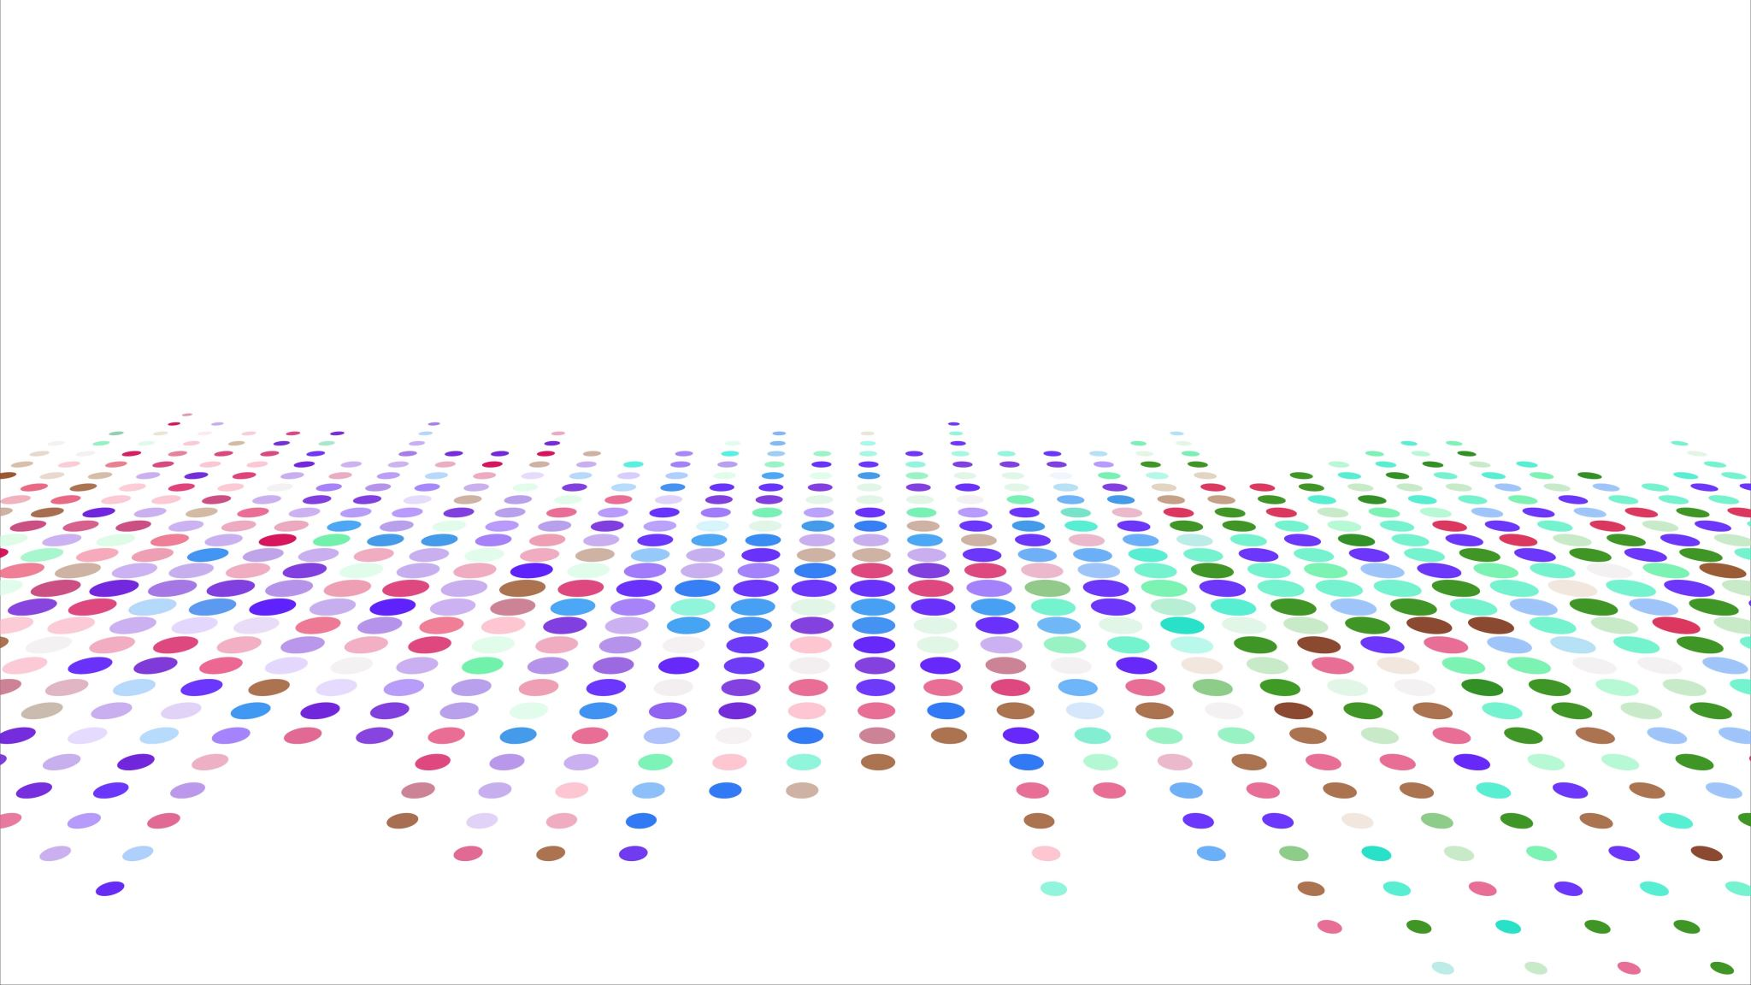
Augmented Instruments
What is the Cyberinet?

Slide 4
What is an Augmented Instrument?
Augmented Instruments are any instrument that has been altered or enhanced from its base capabilities in some way.
This can be done in a variety of methods.
Augmentation methods can be any combination of manual, automatic, acoustic, or electronic.
Many modern augmentations include electronic components and sensors.
Reid, Sarah, Sithi-Amnaui, Sara, & Kapur. Ajay. (2018). Women who Build Things: Gestural Controllers, Augmented Instruments, and Musical Mechatronics. Proceedings of the International Conference on New Interfaces for Musical Expression, 178-183.

Slide 5
Eras of Augmented Instruments
Early
“Recent” Acoustic
Modern/Electronic
Completely acoustic.
Generally looking to improve an instrument or crate a new one
Brass Mutes
Angled violin necks
Mainly acoustic, more electronic as electronics and computers are invented and improved.
Generally exploring new timbres
Prepared Piano
Amplification
Generally, include electronic capabilities, especially as technology continually improves.
Exploring new timbres and instrument functionality.
MIGSI Trumpet
SABRe
Overtone Violin
MataSax

Slide 6
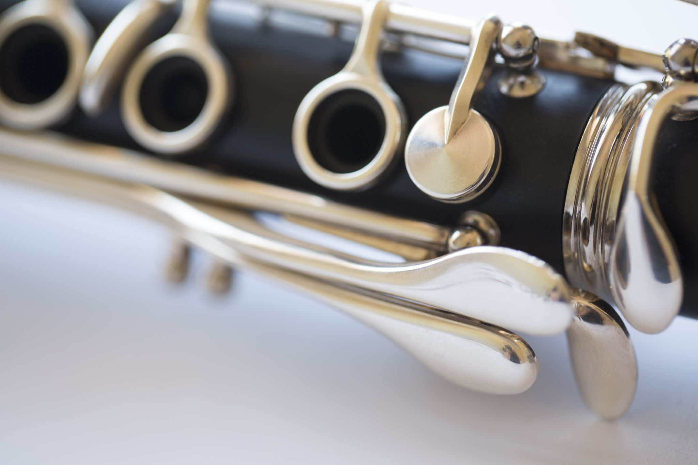
Cybernetic + Clarinet

Slide 7
What is Cybernetic About it?
Cybernetic: The science of communications and automatic control systems in both machines and living things – Oxford Dictionary
Definition ca. 1948 from the Greek “Kubernetes” meaning captain, pilot, conductor, etc.
The Cyberinet is used to collect performance data and automatically control the audio processing and other electronic elements of an electroacoustic performance.

Slide 8
Why use this Instrument?
The Cyberinet is a sensor array designed to be easily adapted the instrument for electronic music without impeding the performance of the instrument.
The device can be easily added or removed from a standard Bb Clarinet whenever needed.
The Cyberinet can still be used as a regular clarinet barrel while powered off.
Creates sound and control possibilities with minimal additional knowledge.
Components are all common-place and use standard pin spacings.
Can be used as a compositional AND performance tool.

Slide 9
Why use this Instrument?
Can easily add harmonic capabilities to the Clarinet.
Intuitive controls

Slide 10
Components Included
The main Cyberinet is comprised of a main unit and smaller secondary unit.
Main Unit:
1200mAh Li-Po battery to power the device.
TP-4056 board. (controls the charging and power distribution
MPU-6050 board. (6 axis gyroscope and accelerometer)
SDP-31 Qwiic Connect board. (differential air pressure/flow and temperature)
ESP-32 DEVKIT board. (microcontroller and transmitter)
2 programmable LEDs.
Secondary Unit:
2 momentary switches with independently programmable LEDs

Slide 11
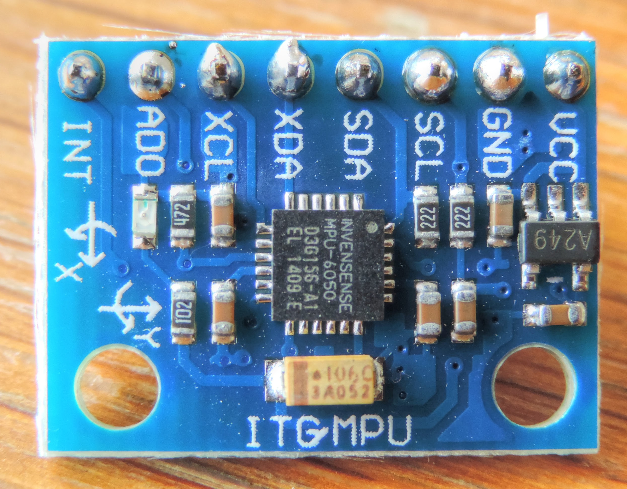
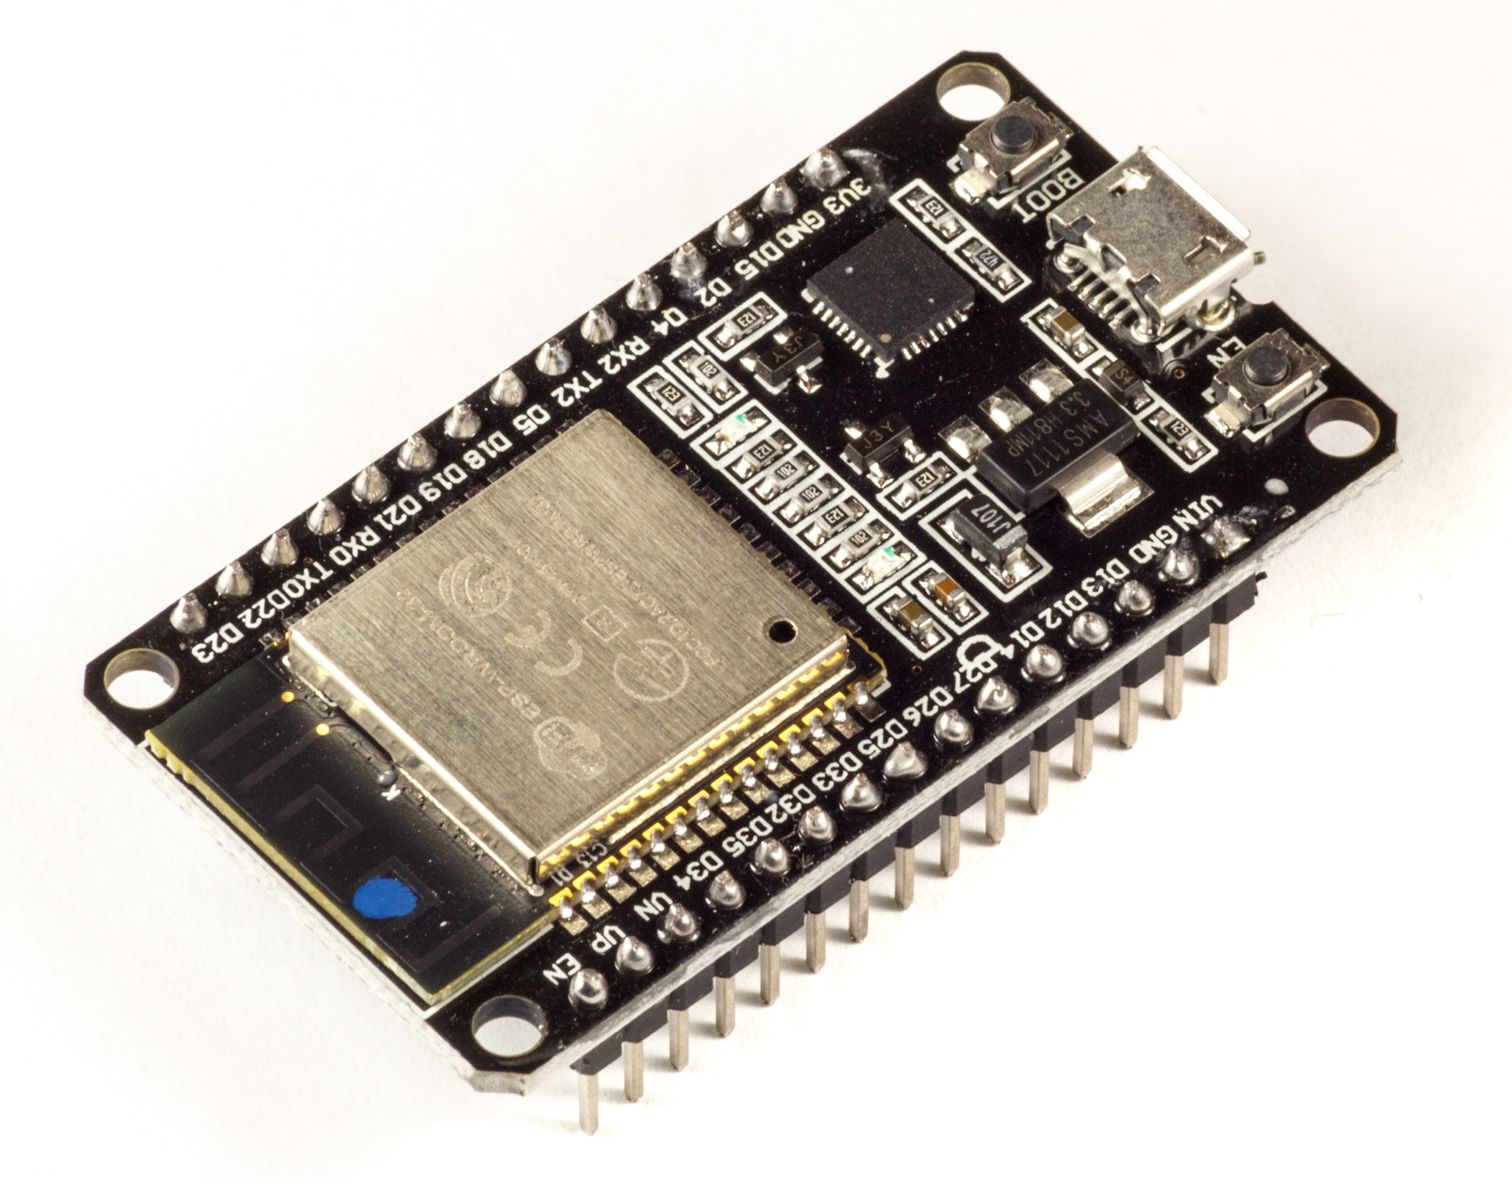
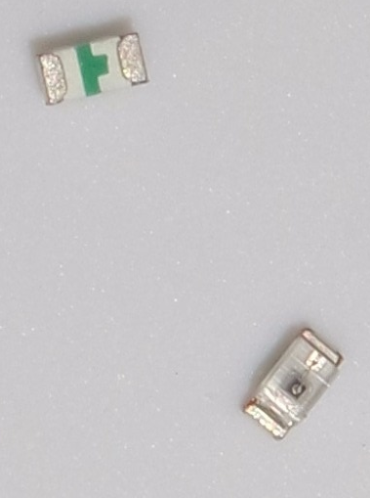
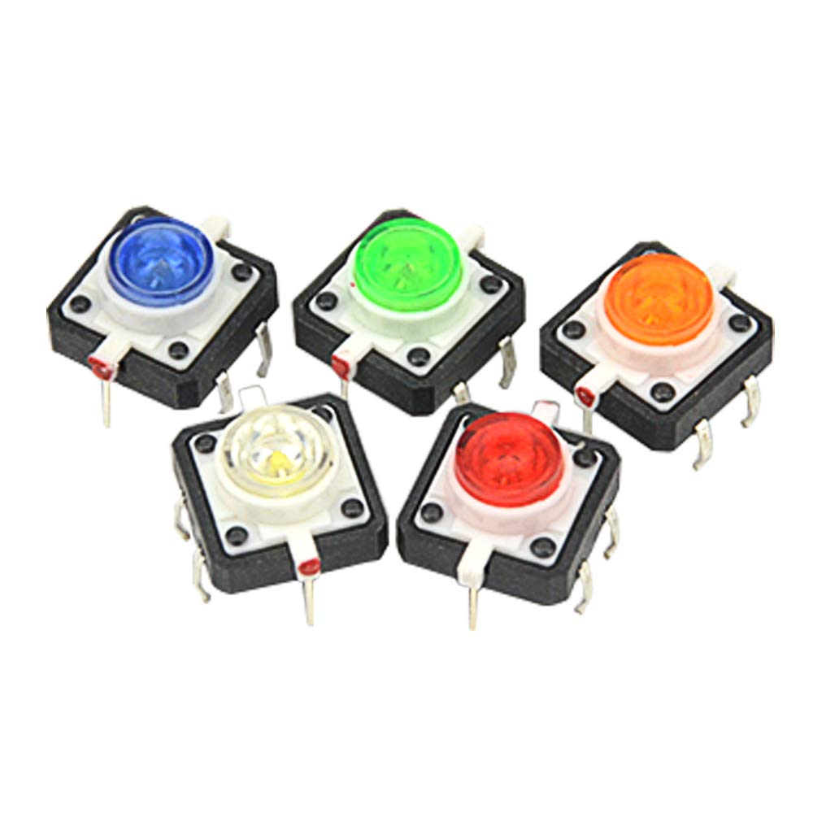
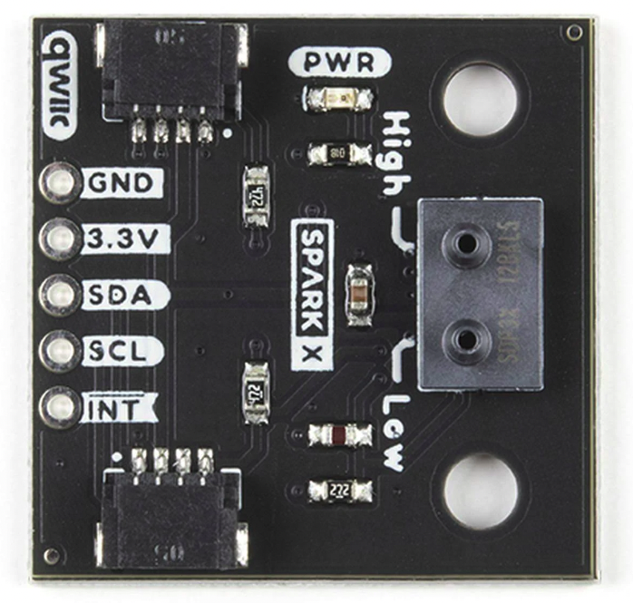
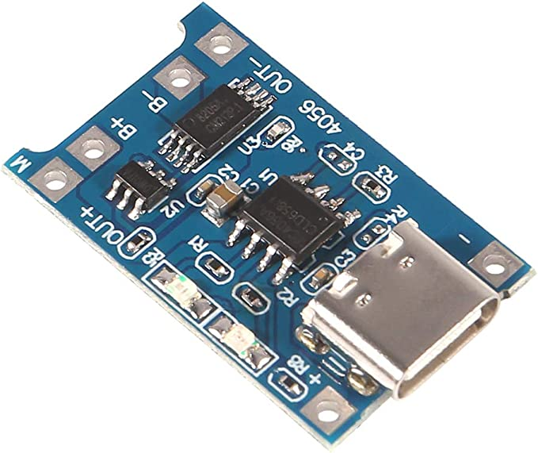
Version 1 Components

Slide 12
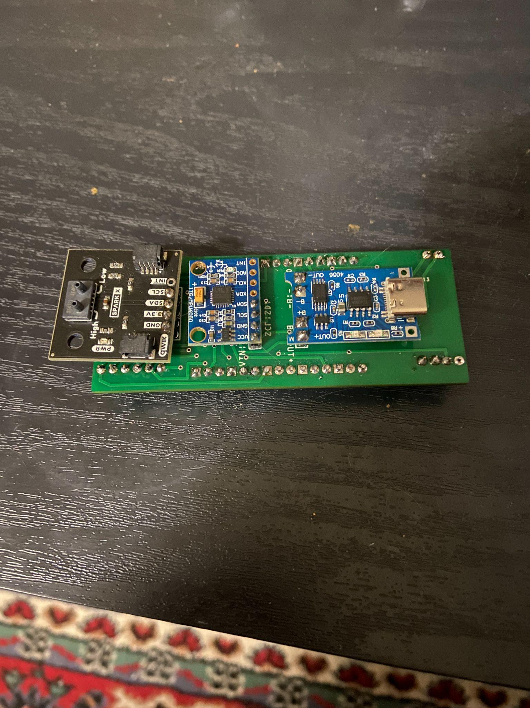
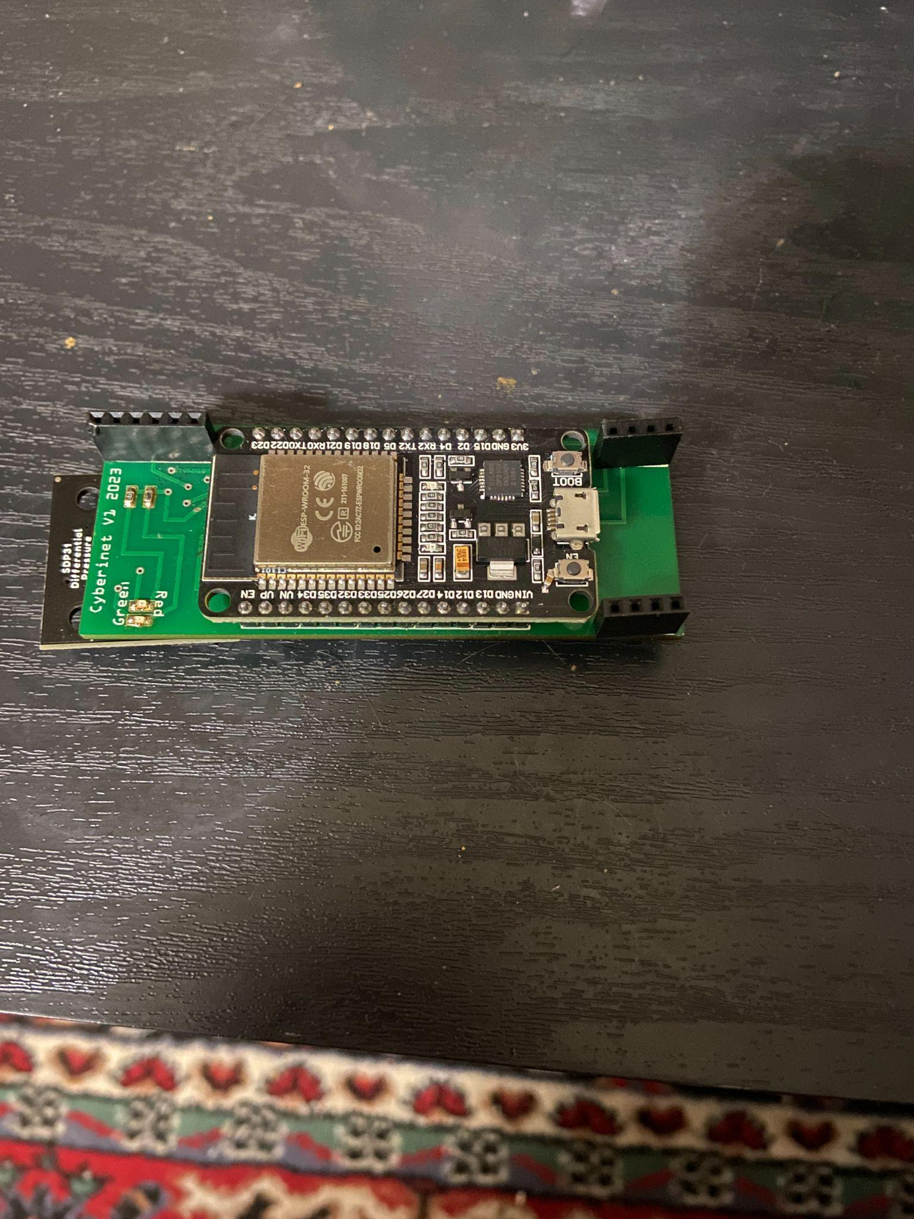
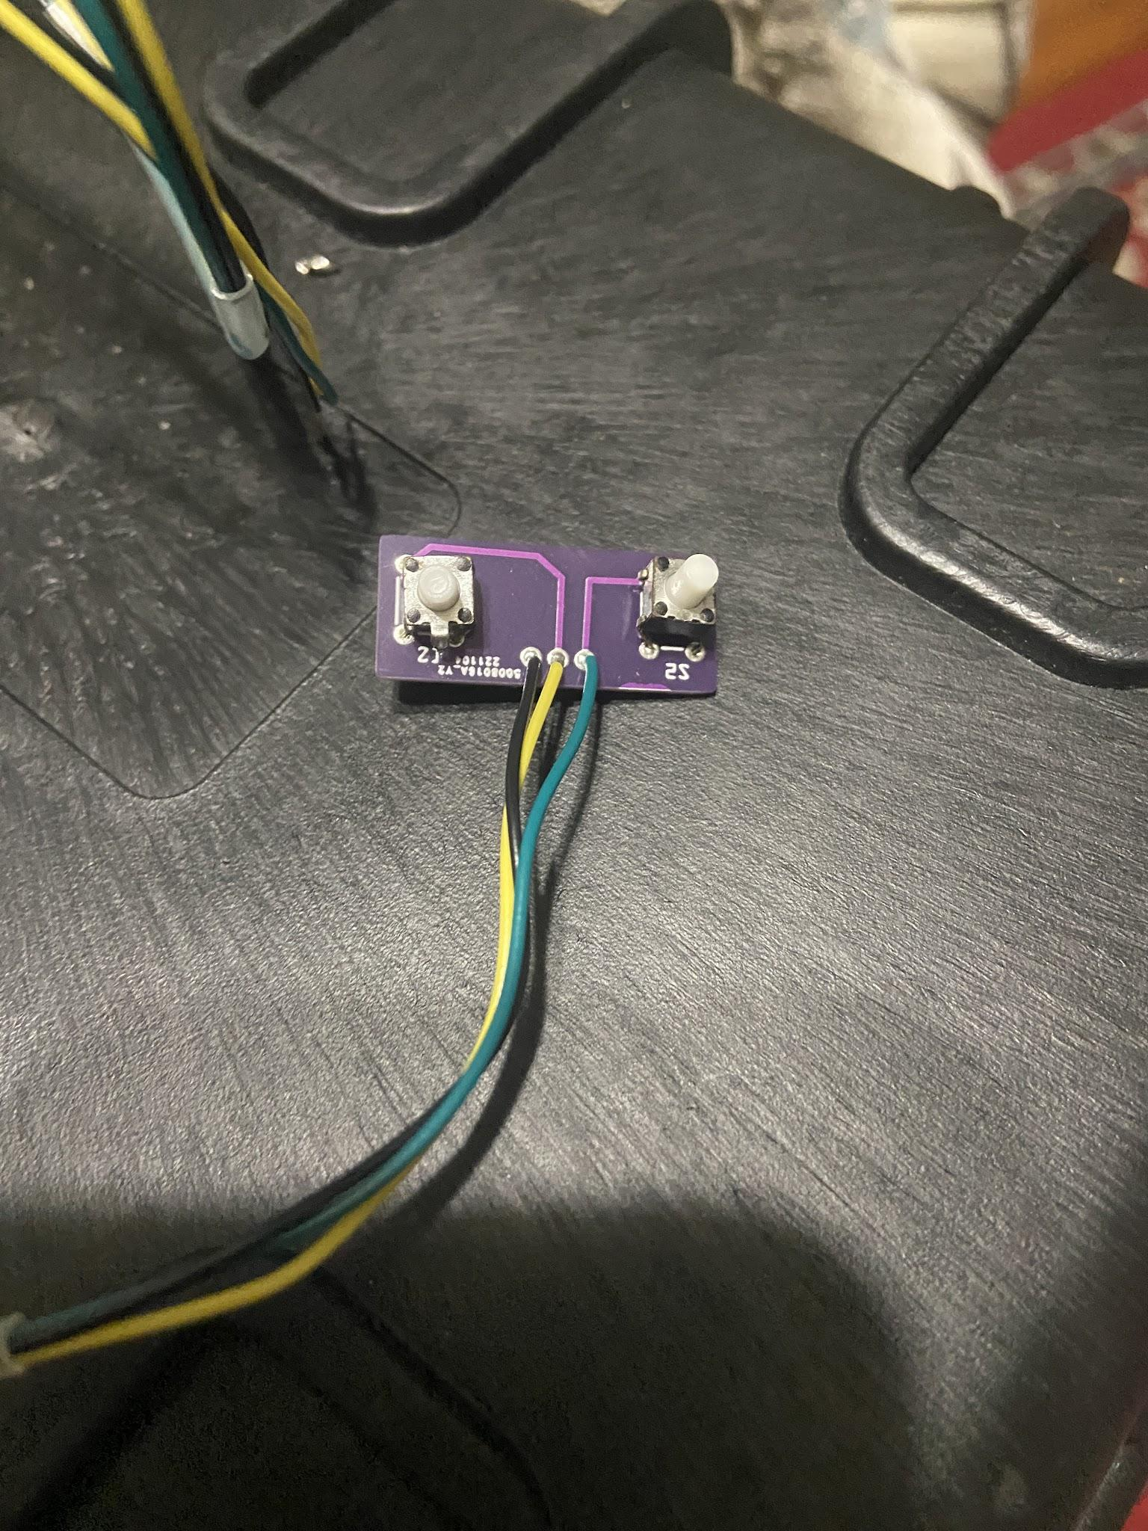
Top
Bottom
Buttons
Main Unit & Button Expansion Prototypes

Slide 13
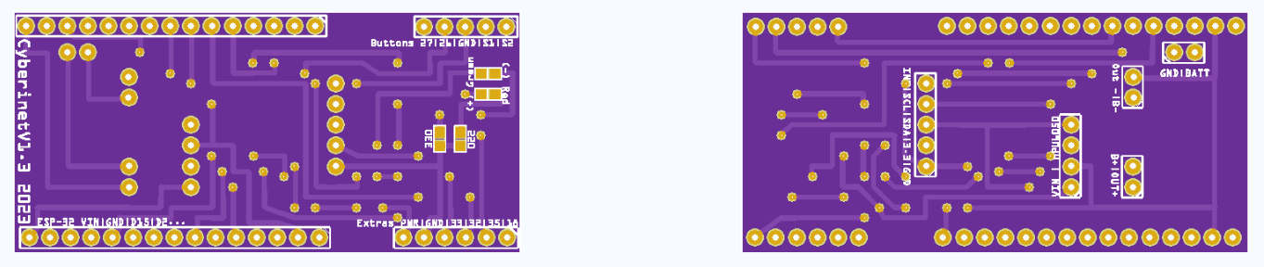
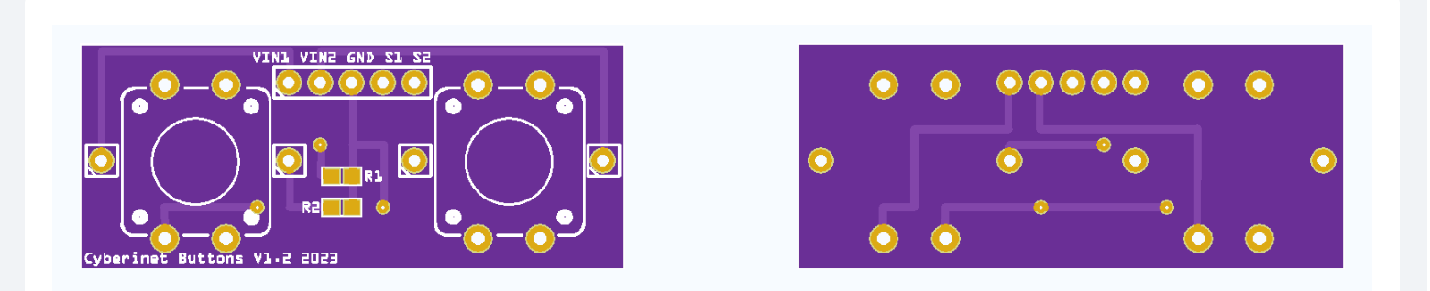
Main Board
Version 1 PCB Diagrams
Button Expansion

Slide 14
Future Optional add-ons
To further expand the functionality of the Cyberinet, multiple optional expansion units contain a variety of other sensors and can be utilized through the same expansion port. These include:
Microphone
Finger pressure sensors
Secondary movement sensor
Speaker
All of these are still in development, with the microphone closest to being functional.

Slide 15

Music

Slide 16
Puzzle of a Park (2023)
Written to utilize the optional button add-on.
Performer triggers the on-stage microphone & playback of recordings with a single button.
Functions similarly to a loop pedal.

Slide 17
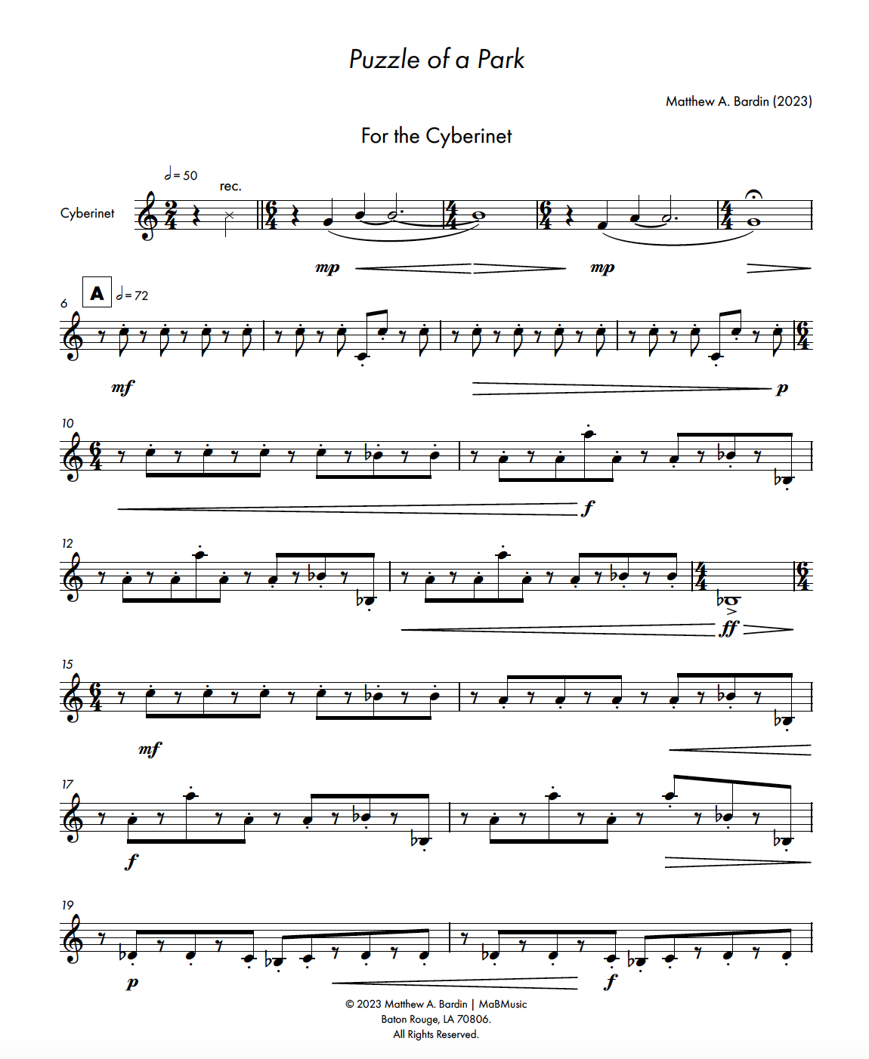
Adam Cope- Cyberinet
Puzzle of a Park opening page

Slide 18
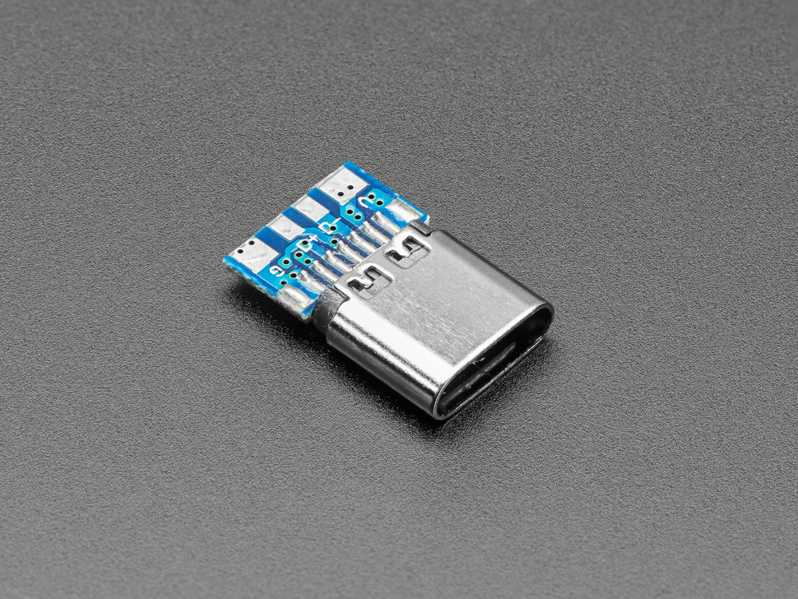
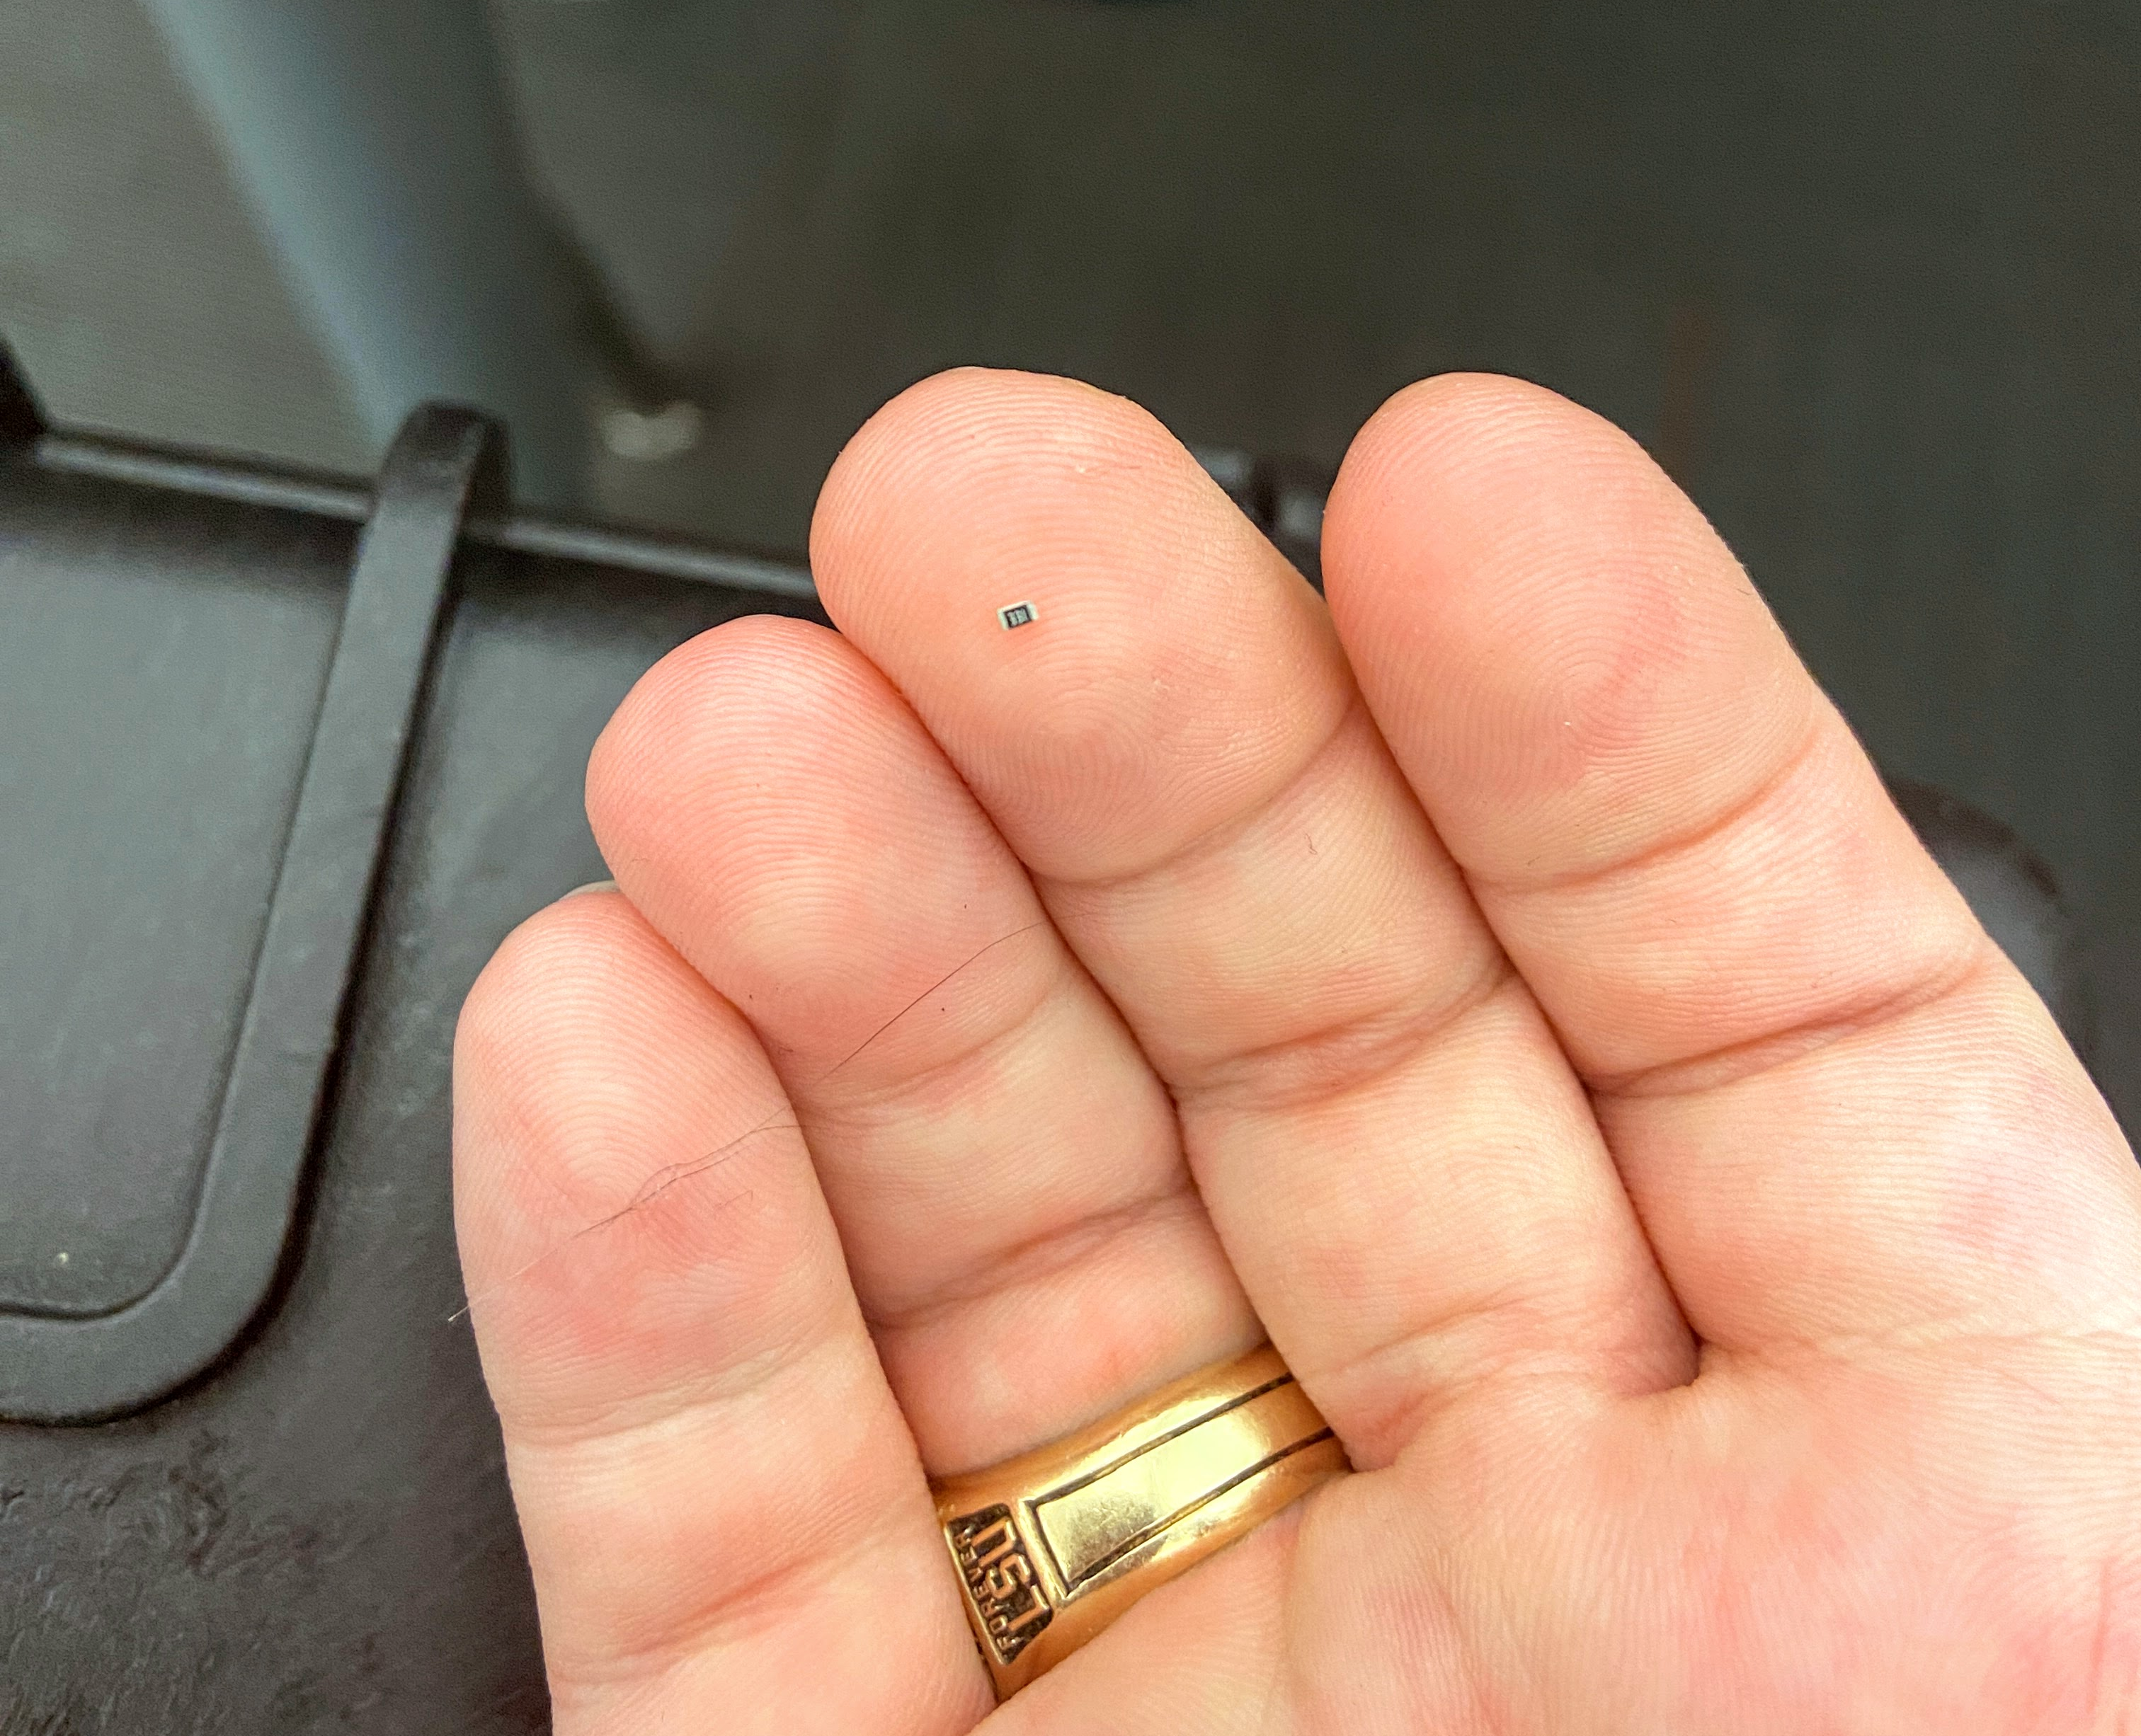
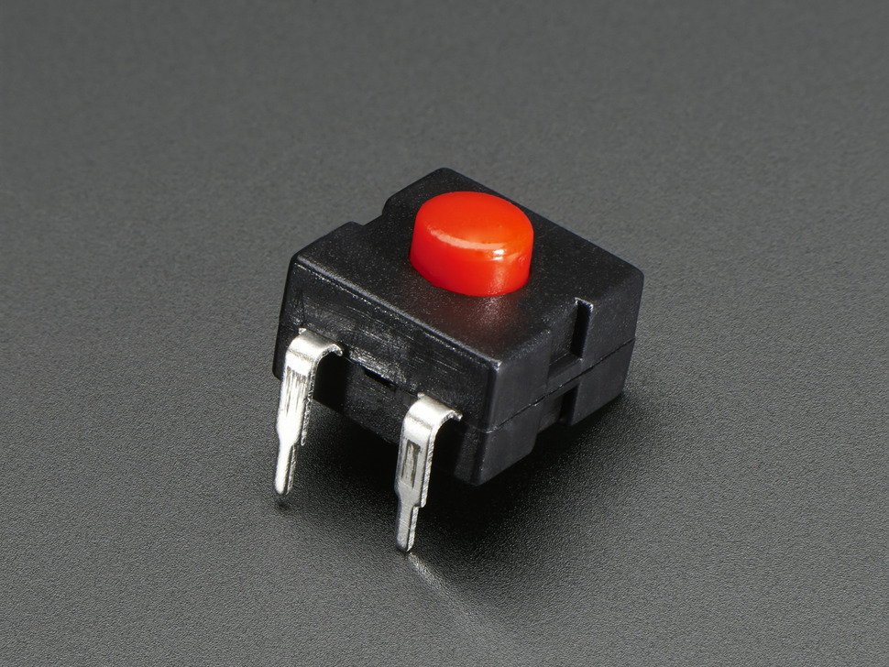
Assembling the Unit
1:
Attach LEDs and Resistors (SMD Components) to the PCBs.
2:
Solder the USB-C and JST connectors. These are supported by the outer case.
3:
Solder the larger components directly to the PCBs. The microcontroller and SDP chip should be elevated with pin headers.
4:
Add the power switch. When done, connect the battery Glue/sSand as needed.

Slide 19
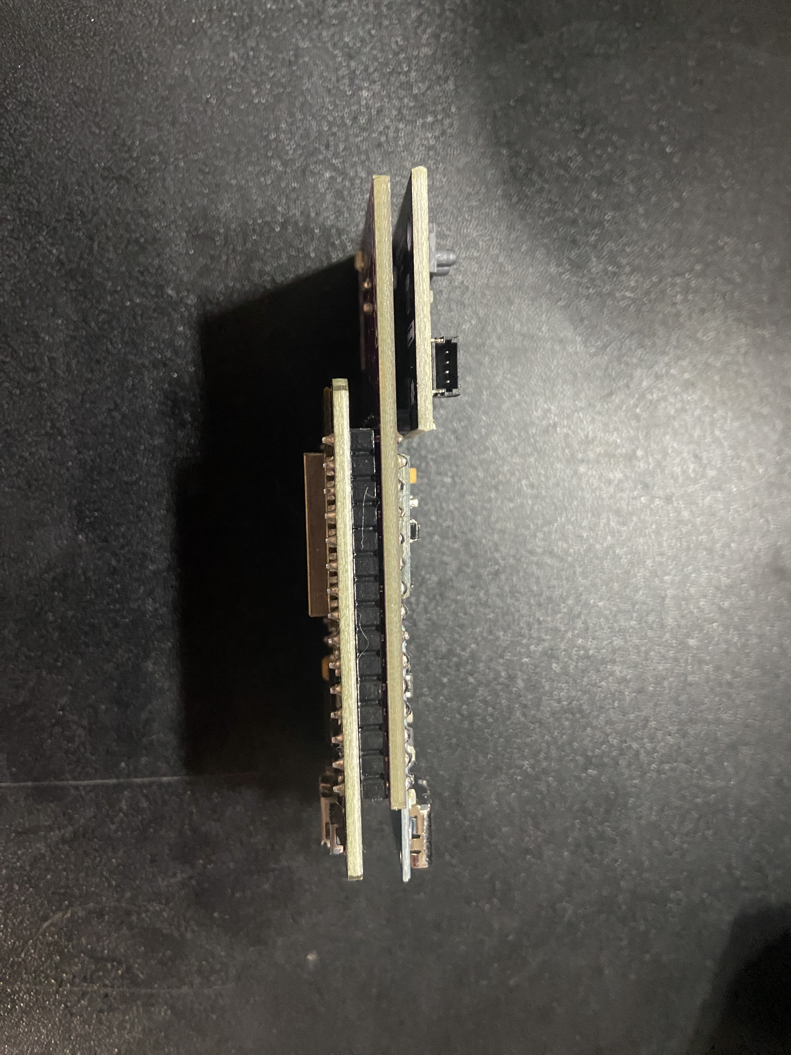
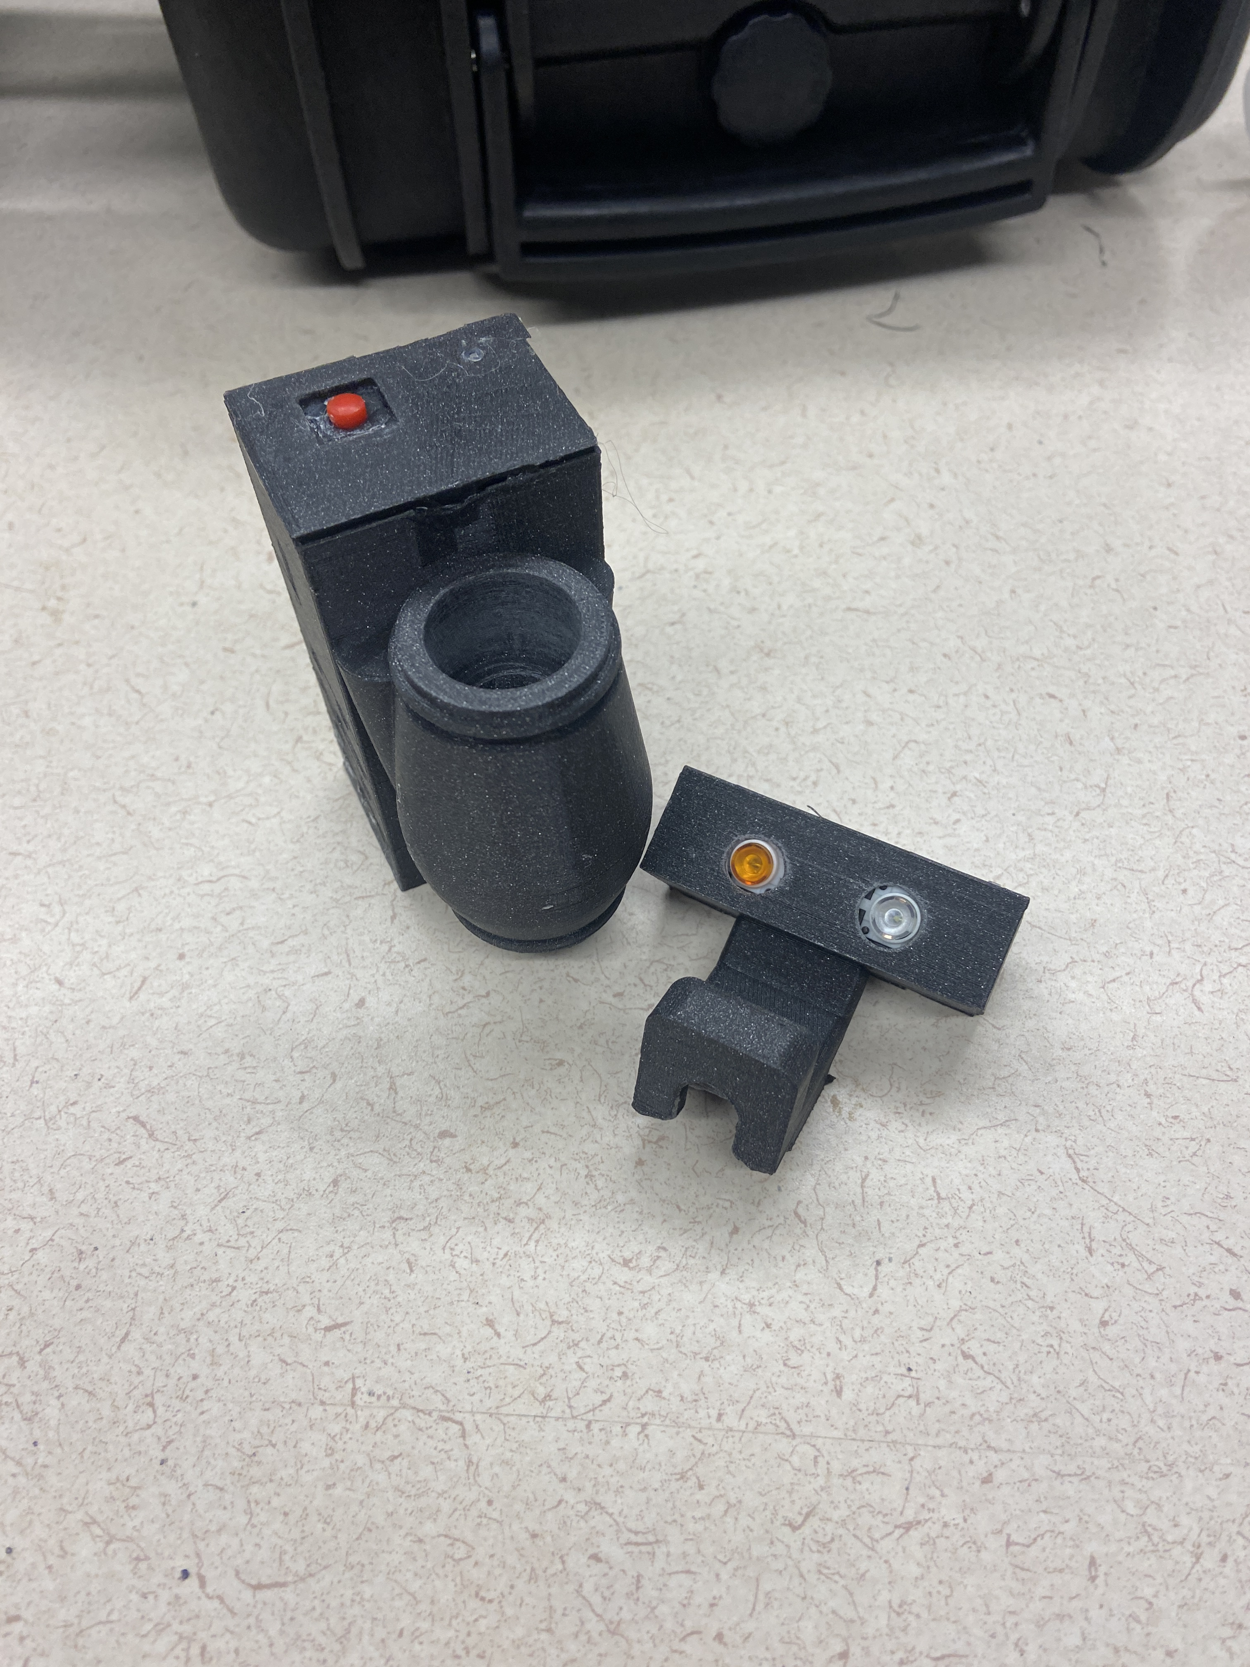
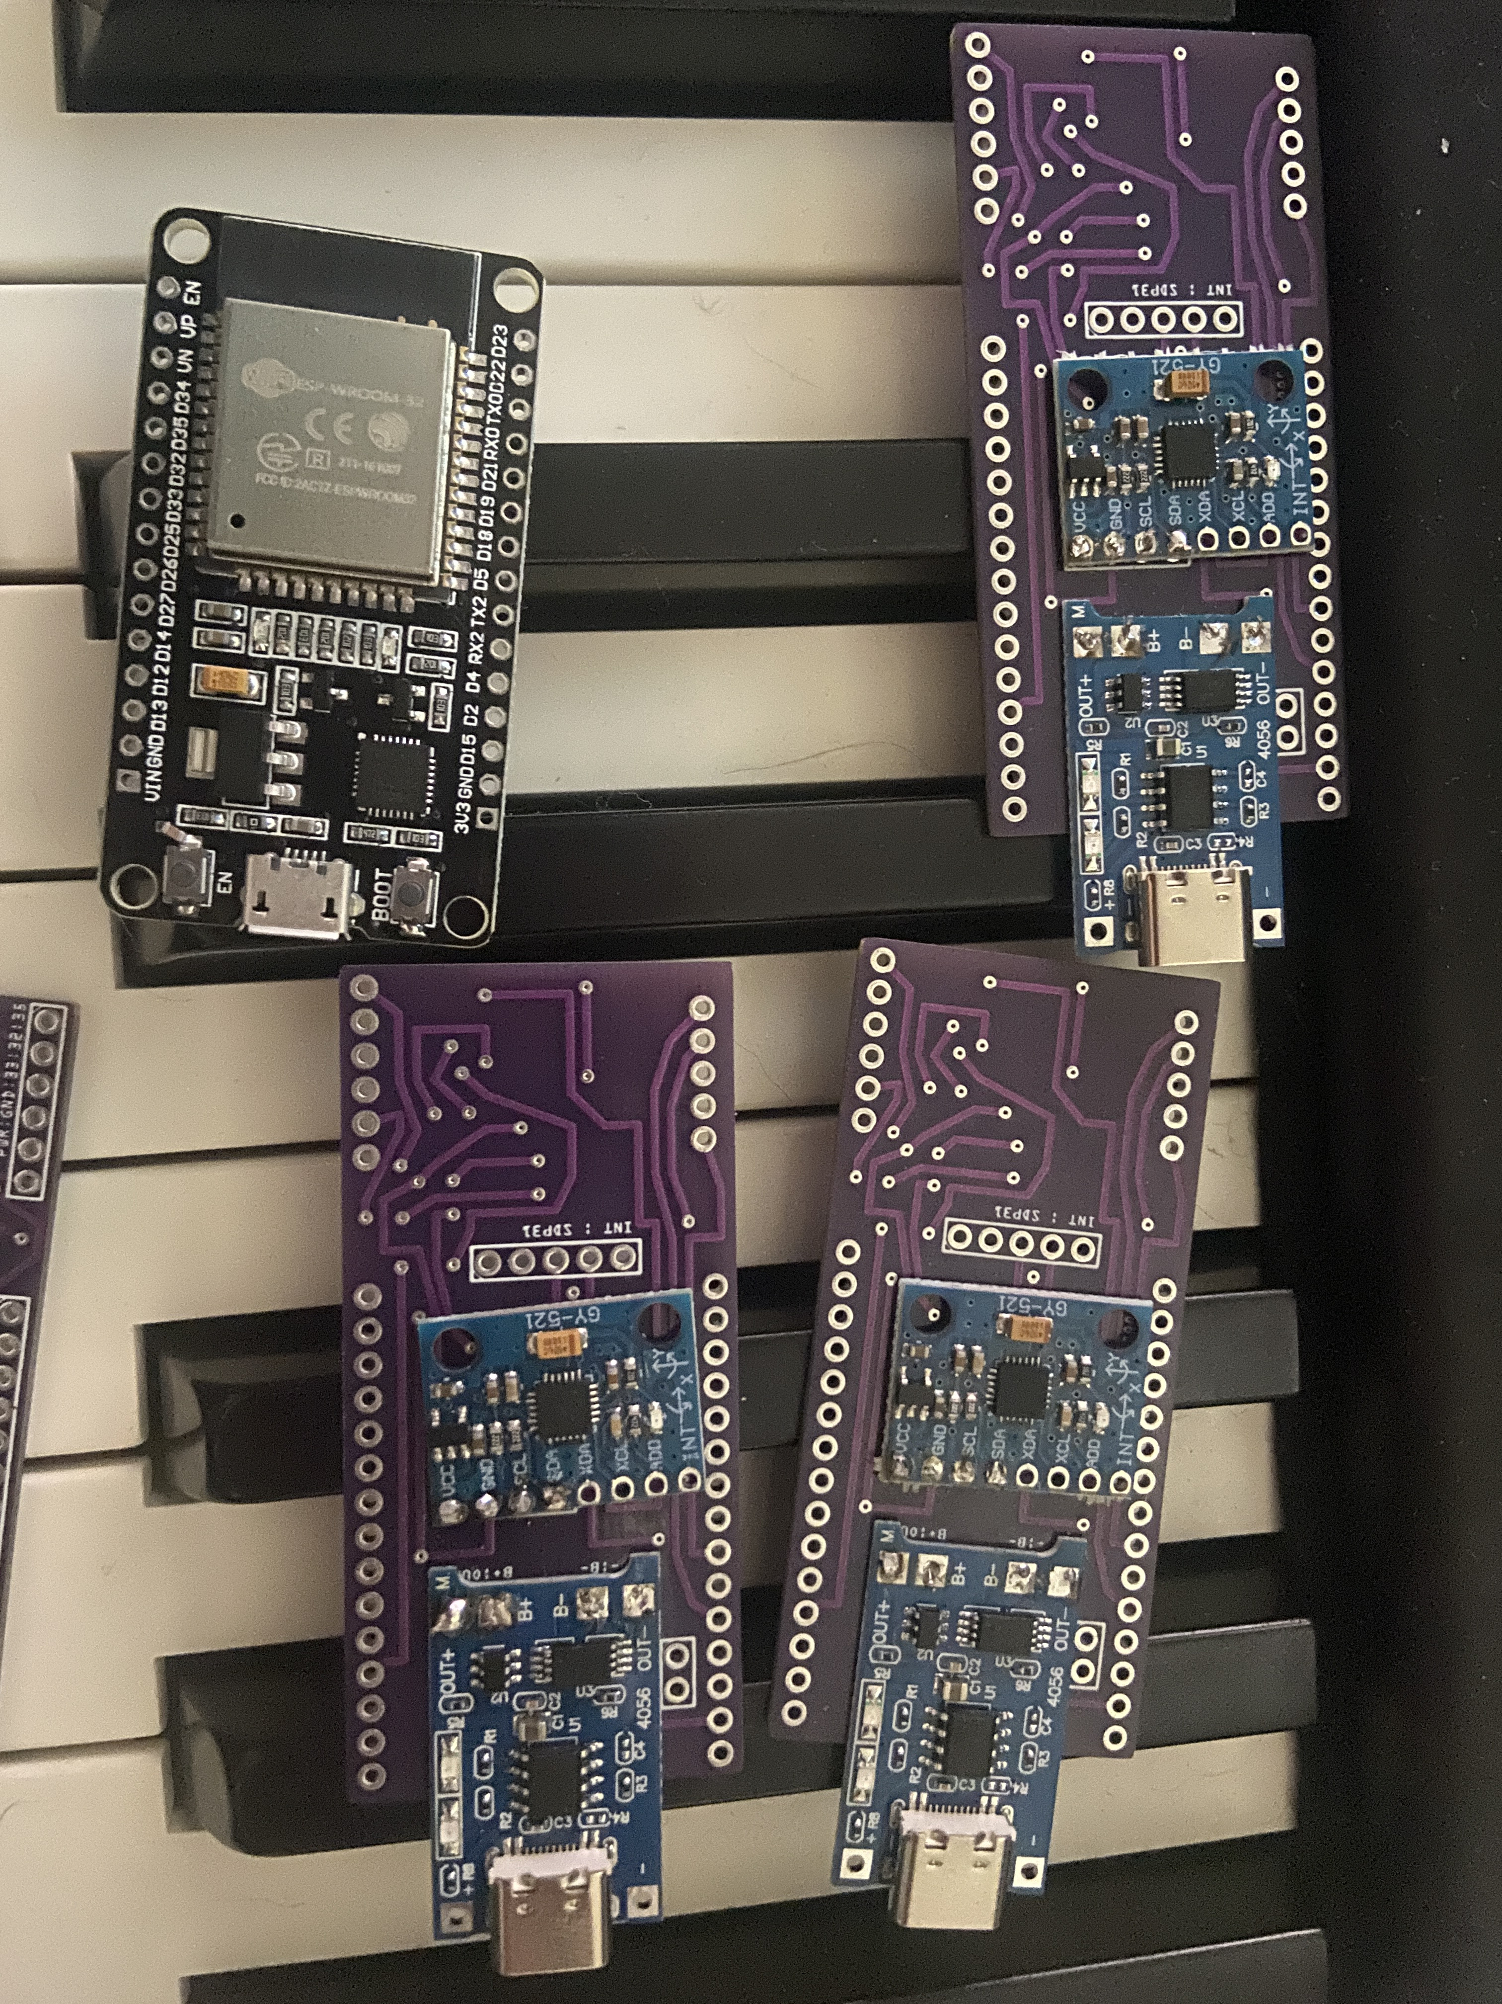
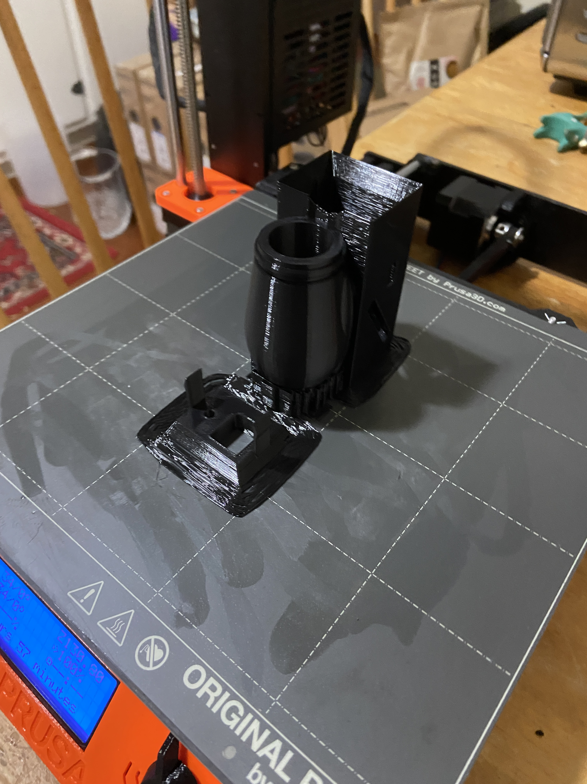
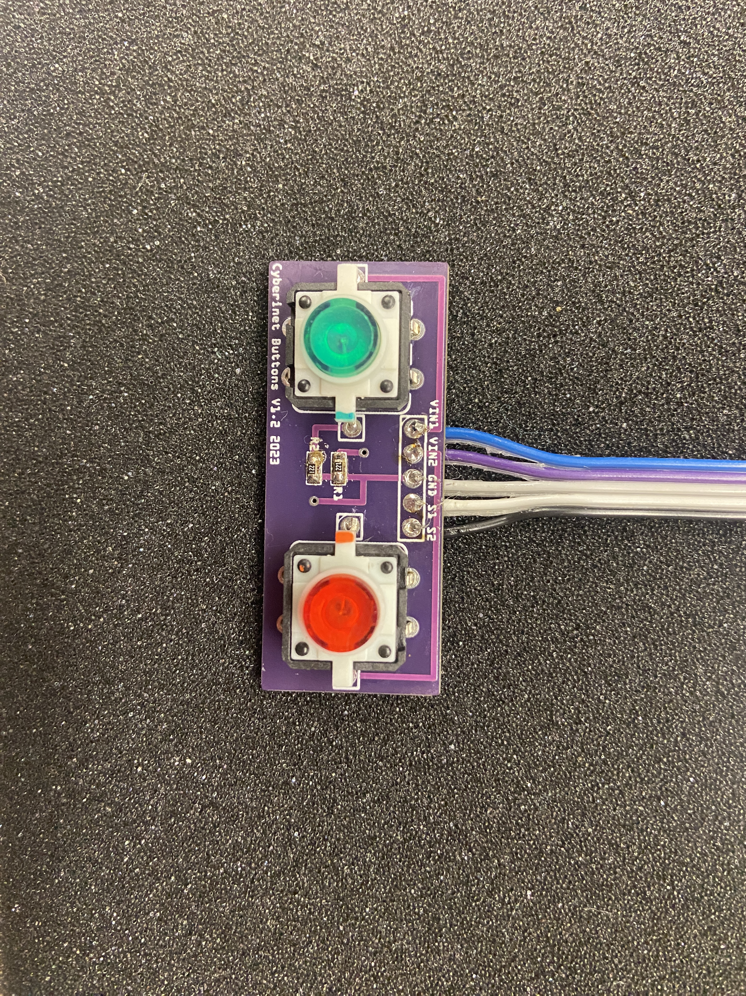
Version 1 with Button Board (with and without housing)

Slide 20
How the Cyberinet works

Slide 21

Collects data
The Cyberinet’s .ino code and attached sensors manage the collection of the performance data.
SDP31: Measures differential air pressure between the inside and outside of the instrument. Small tubes connect to the sensor to facilitate this. Also measures temperature.
MPU6050: Measures performer movement in 6 axis.
Buttons: triggerable by the performer

Slide 22
Transmits wirelessly
The main unit’s ESP-32 board the transmitting as well as the data collection.
By utilizing the Arduino library “BluetoothSerial” the DEVKIT can transmit serial communications through a Bluetooth connection. The device name is “CyberinetV1X” and currently requires no password to connect.
These values can be read by any serial terminal program on the host device. The Max objects utilize an additional node script to receive the data more reliably.

Slide 23
Performer Opinions
We will take a few seconds to ask Adam about his thoughts with using the device.
He hasn’t been told about this.
What are your honest opinions on the usability, flexibility, and anything else you would like to mention?

Slide 24
Music

Slide 25
Ethereal Presence (2022)
Utilizes gyroscope and airflow sensors
As the performer moves, the position of their instrument changes the pitch content of the accompaniment.
Computer synthesis has 2 main textures:
Filtered pink noise to provide backing texture
Modified FM synthesis to provide accompaniment to the soloist
Music alters between different styles to encourage a variety of performance movements.
Wide tempo variety helps encourage a non-identical performances.

Slide 26
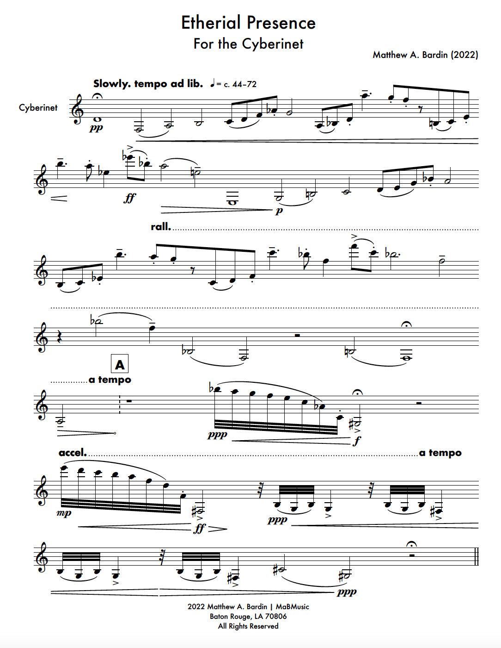
Adam Cope- Cyberinet
Ethereal Presence opening page

Slide 27
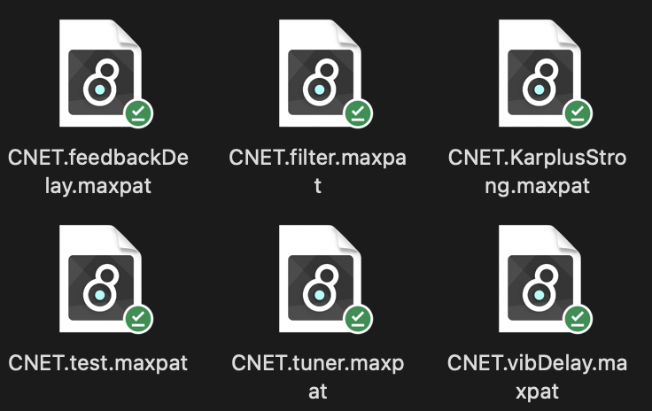
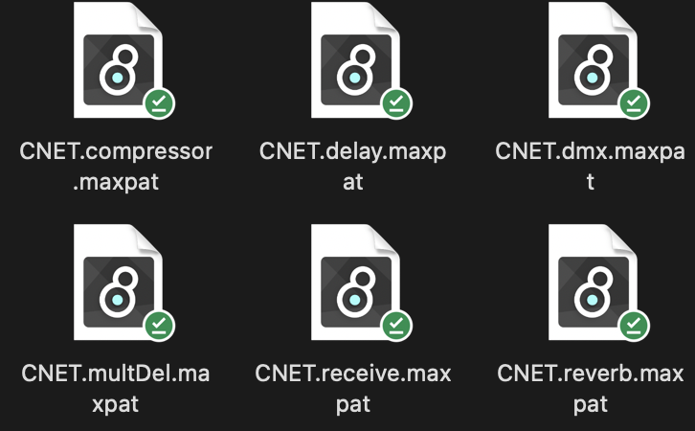
Processing/Manipulation in Max
The main goal of the Cyberinet is to collect and transmit the sensor data.
From there it is largely up to the user to decide what they want to to with the data.
To help with that I have also created a series of Max patches that can be used to control various elements of a Max patch including:
Reverb
Various Delays
Gain
Debug testing tool
Tuner
Playback Control
DMX Control
More coming soon!

Slide 28
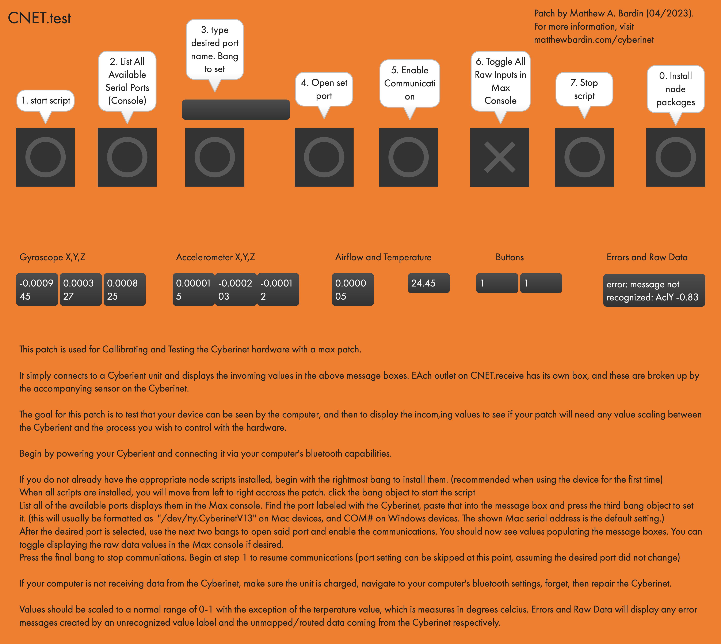
Max Patches Continued
CNET.receive receives all the data from the Cyberinet, sorts and scales it for use, then outputs the numbers to unique object outlets.

Slide 29
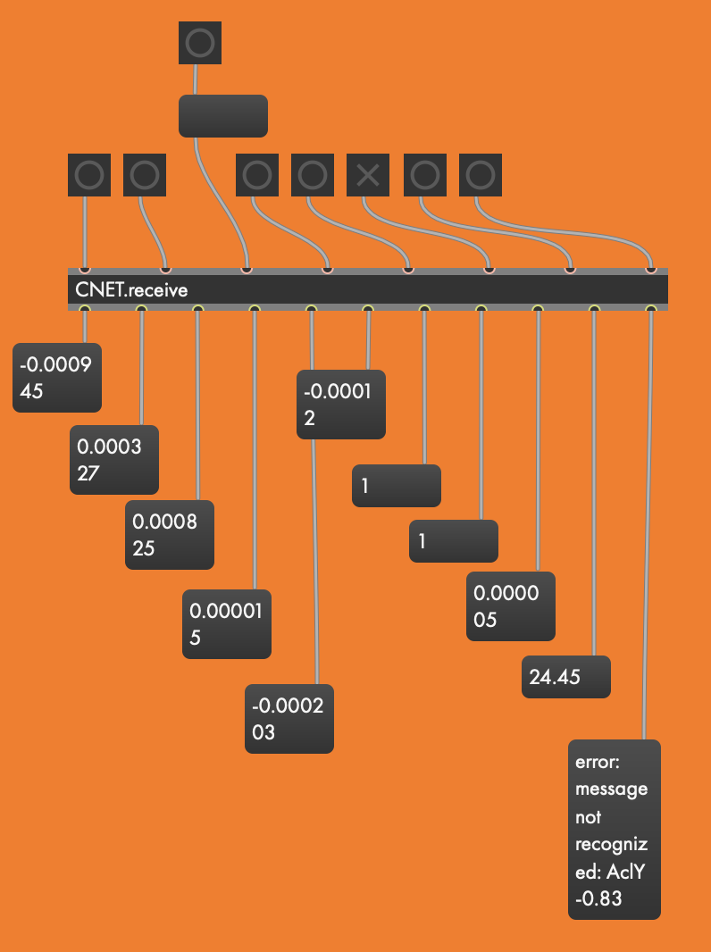
Main view of the CNET.test patch

Slide 30
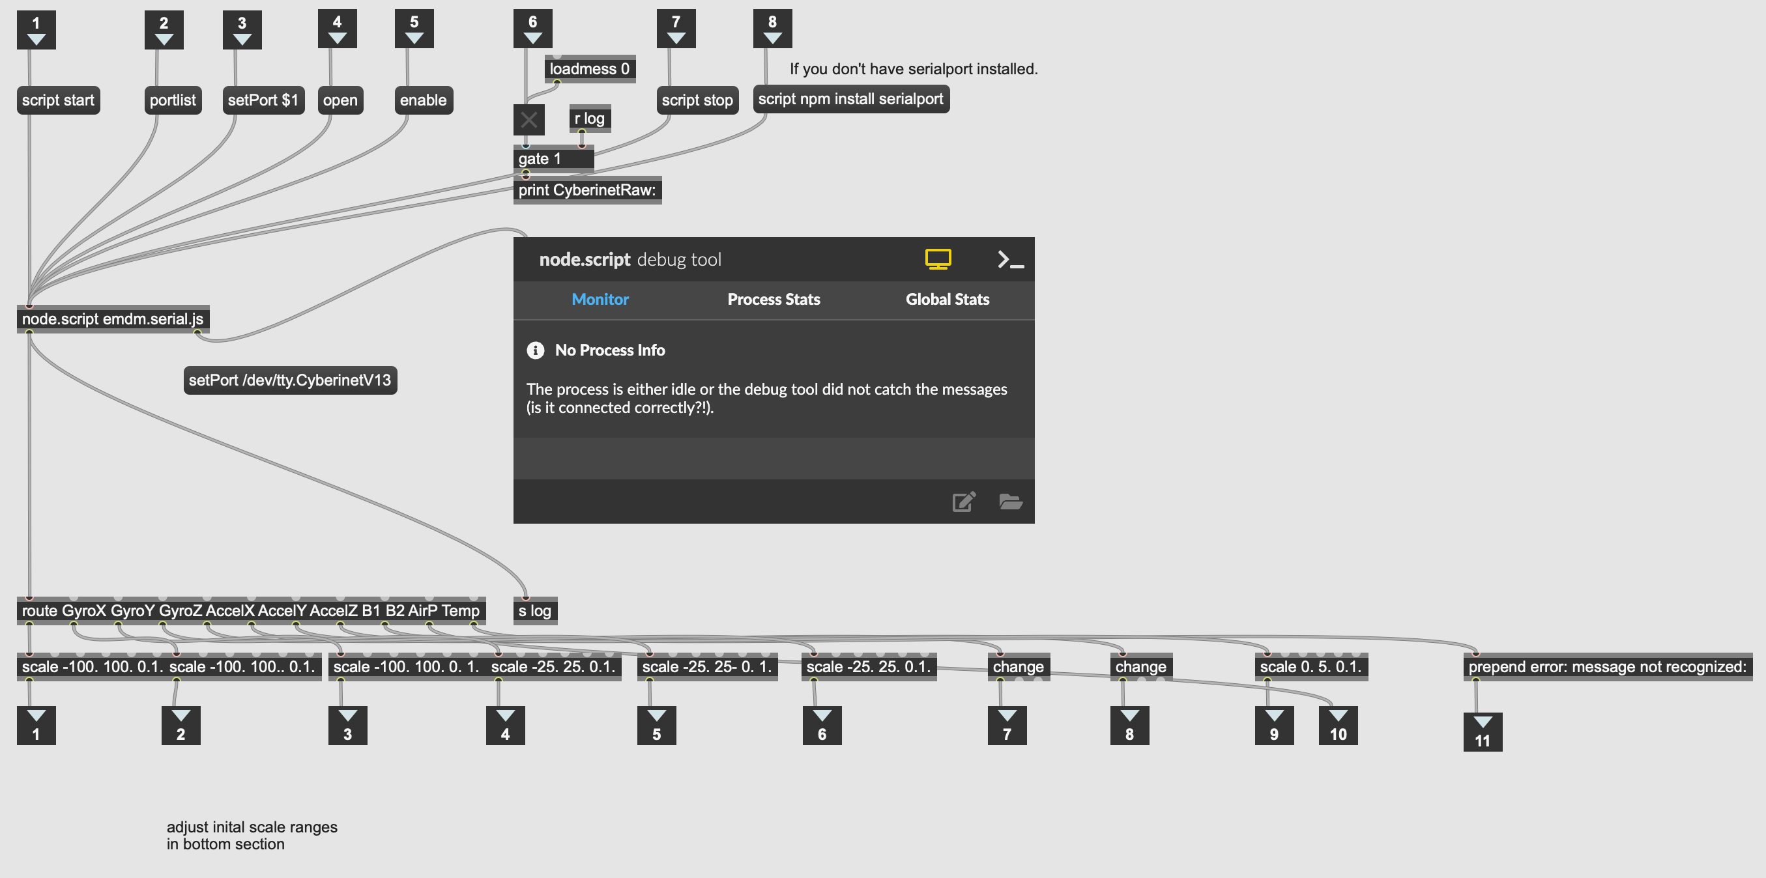
CNET.recieve patch inner workings

Slide 31

Sending data to other programs
Data from the Cyberinet can be read by any software capable of receiving Serial data.
Simply connect the Cyberinet to the host computer and use the software’s ability to read serial data.
Programs like Max can then convert the messages to different formats and transmit them to other devices and softwares as needed.

Slide 32
Online Resources

Slide 33
Github Repo
github.com/mbardin/Cyberinet
Contains all code, diagrams, and other information

Slide 34
Code, Patches and Diagrams
Cyberinet units will be available for purchase at a future date.
All materials are open-source.
A person can build their own unit using the online resources

Slide 35
Music

Slide 36
Raindrops on a Tin Roof (2022-2023)
Utilizes all the included sensors:
Gyroscope/Accelerometer
Airflow
Buttons
The performer cues up various sound files and musical sections using the buttons.
Other sensors are used to control the processing of the sounds.

Slide 37
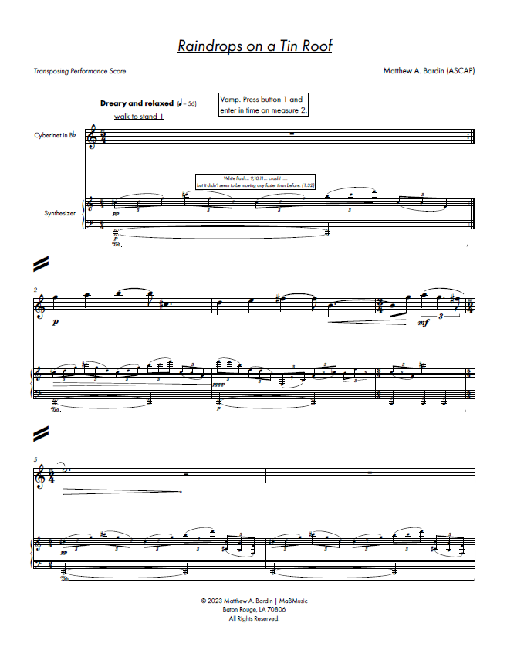
Adam Cope - Cyberinet
Matthew Bardin - Narrator
Raindrops on a Tin Roof
opening page

Slide 39
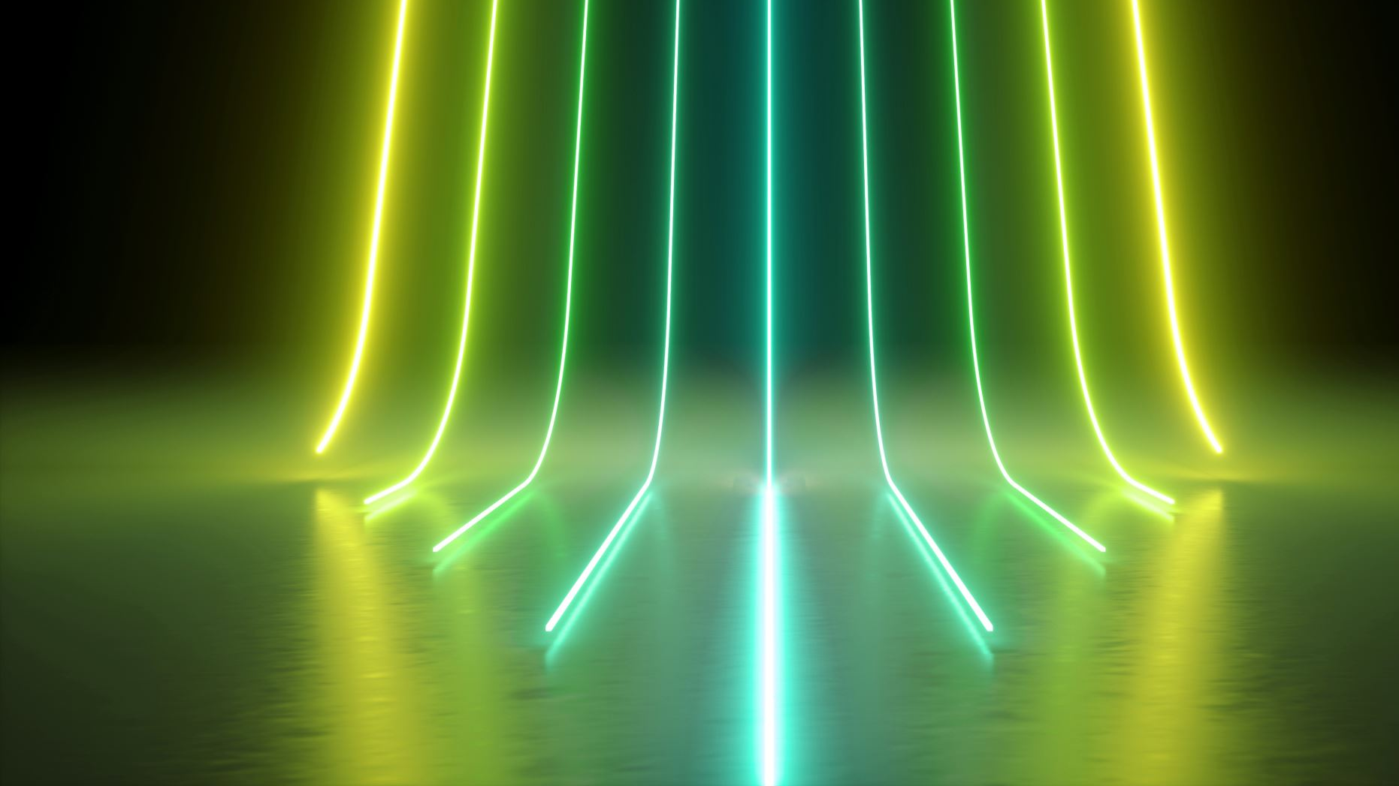
Future Directions

Slide 40
Potential Future Directions Include:
Optimal serial communications for Windows and Mac operating systems.
Permanent embedding within a clarinet.
Making versions for other instruments.
OSC Formatting for easier multi-platform use cases.
Password locking units to avoid miss-connections.

Slide 41
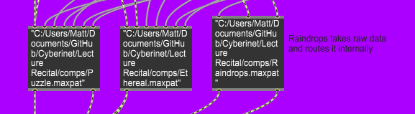
All the compositions are available in Max.
40
Each of the patches used to make these performances has been created as an object in Max. Performers can download these from the GitHub repo for performance, or experiment with their own processing.
Scores, patches and other info available at matthewbardin.com

Slide 42

Questions?

Slide 43

Thank You for coming!

